Slide 1
The columnar roadmap:
Apache Parquet and Apache Arrow
Julien Le Dem, Principal Architect Dremio,
VP Apache Parquet, Apache Arrow PMC

Slide 2
Julien Le Dem
@J_
Julien
Architect at @DremioHQ
Formerly Tech Lead at Twitter on Data Platforms.
Creator of Parquet
Apache member
Apache PMCs: Arrow, Kudu, Incubator, Pig, Parquet

Slide 3
Agenda
Community Driven Standard
Benefits of Columnar representation
Vertical integration: Parquet to Arrow
Arrow based communication

Slide 4
Community Driven Standard

Slide 5
An open source standard
Calcite
Cassandra
Deeplearning4j
Drill
Hadoop
HBase
Ibis
Impala
Kudu
Pandas
Parquet
Phoenix
Spark
Storm
R
Parquet: Common need for on disk columnar.
Arrow: Common need for in memory columnar.
Arrow is building on the success of Parquet.
Top-level Apache project
Standard from the start:
Members from 13+ major open source projects involved
Benefits:
Share the effort
Create an ecosystem

Slide 6
Interoperability and Ecosystem
Before
With Arrow
Each system has its own internal memory format
70-80% CPU wasted on serialization and deserialization
Functionality duplication and unnecessary conversions
All systems utilize the same memory format
No overhead for cross-system communication
Projects can share functionality (eg: Parquet-to-Arrow reader)

Slide 7


Benefits of Columnar representation

Slide 8

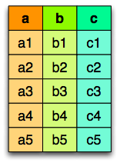
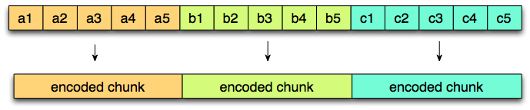
Columnar layout
Logical table
representation
Row layout
Column layout
@EmrgencyKittens

Slide 9
On Disk and in Memory
Different trade offs
On disk: Storage.
Accessed by multiple queries.
Priority to I/O reduction (but still needs good CPU throughput).
Mostly Streaming access.
In memory: Transient.
Specific to one query execution.
Priority to CPU throughput (but still needs good I/O).
Streaming and Random access.

Slide 10
Parquet on disk columnar format

Slide 11
Parquet on disk columnar format
Nested data structures
Compact format:
type aware encodings
better compression
Optimized I/O:
Projection push down (column pruning)
Predicate push down (filters based on stats)

Slide 12
Parquet nested representation
Borrowed from the Google Dremel paper
Columns:
docid
links.backward
links.forward
name.language.code
name.language.country
name.url
https://blog.twitter.com/2013/dremel-made-simple-with-parquet

Slide 13
Access only the data you need
Read only the data you need!
Columnar
Statistics

Slide 14
Parquet file layout

Slide 15
Arrow in memory columnar format

Slide 16
Arrow goals
Well-documented and cross language compatible
Designed to take advantage of modern CPU
Embeddable
in execution engines, storage layers, etc.
Interoperable

Slide 17
Arrow in memory columnar format
Nested Data Structures
Maximize CPU throughput
Pipelining
SIMD
cache locality
Scatter/gather I/O

Slide 18
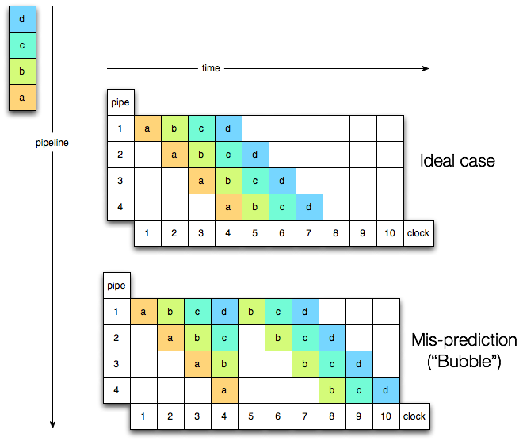
CPU pipeline

Slide 19
Columnar data
persons = [{
name: ’Joe',
age: 18,
phones: [
‘555-111-1111’,
‘555-222-2222’
]
}, {
name: ’Jack',
age: 37,
phones: [ ‘555-333-3333’ ]
}]

Slide 20
Record Batch Construction
Schema Negotiation
data header (describes offsets into data)
{
name: ’Joe',
age: 18,
phones: [
‘555-111-1111’,
‘555-222-2222’
]
}
Dictionary Batch
name (bitmap)
name (offset)
name (data)
age (bitmap)
Record Batch
age (data)
phones (bitmap)
Record Batch
phones (list offset)
phones (offset)
Record Batch
phones (data)
Each box (vector) is contiguous memory
The entire record batch is contiguous on wire

Slide 21
Vertical integration: Parquet to Arrow

Slide 22
Representation comparison for flat schema

Slide 23
Naïve conversion

Slide 24
Naïve conversion
Data dependent branch

Slide 25

Peeling away abstraction layers Vectorized read
(They have layers)

Slide 26
Bit packing case

Slide 27
Bit packing case
No branch

Slide 28
Run length encoding case

Slide 29
Run length encoding case
Block of defined values

Slide 30
Run length encoding case
Block of null values

Slide 31
Predicate push down

Slide 32
Example: filter and projection

Slide 33
Naive filter and projection implementation

Slide 34
Peeling away abstractions

Slide 35
Arrow based communication

Slide 36
Universal high performance UDFs

Slide 37
Arrow RPC/REST API
Generic way to retrieve data in Arrow format
Generic way to serve data in Arrow format
Simplify integrations across the ecosystem
Arrow based pipe

Slide 38
RPC: arrow based storage interchange
The memory representation is sent over the wire.
No serialization overhead.

Slide 39
RPC: arrow based cache
The memory representation is sent over the wire.
No serialization overhead.

Slide 40
RPC: Single system execution
The memory representation is sent over the wire.
No serialization overhead.

Slide 41
Results
- PySpark Integration:
53x speedup (IBM spark work on SPARK-13534)
http://s.apache.org/arrowresult1
- Streaming Arrow Performance
7.75GB/s data movement
http://s.apache.org/arrowresult2
- Arrow Parquet C++ Integration
4GB/s reads
http://s.apache.org/arrowresult3
- Pandas Integration
9.71GB/s
http://s.apache.org/arrowresult4

Slide 42
Language Bindings
Parquet
Arrow
Target Languages
Java
CPP
Python & Pandas
Engines integration:
Many!
Target Languages
Java
CPP, Python
R (underway)
C, Ruby, JavaScript
Engines integration:
Drill
Pandas, R
Spark (underway)

Slide 43
Arrow Releases

Slide 44
Current activity:
Spark Integration (SPARK-13534)
Pages index in Parquet footer (PARQUET-922)
Arrow REST API (ARROW-1077)
Bindings:
C, Ruby (ARROW-631)
JavaScript (ARROW-541)

Slide 45
Get Involved
Join the community
dev@{arrow,parquet}.apache.org
Slack:
Arrow: https://apachearrowslackin.herokuapp.com/
Parquet: https://parquet-slack-invite.herokuapp.com/
http://{arrow,parquet}.apache.org
Follow @Apache{Parquet,Arrow}

